Slide 1


QARM II Project
Trend Following, Momentum and High Correlations
Maxime Borel & Benjamin Souane

Slide 2



Agenda
Introduction
Data & Investment Universe
Methodology
Benchmarks
Results & Sensitivity Analysis
Limits and Recommendation
Maxime Borel & Benjamin Souane
QARM II – 17.12.2020
Notes:
B

Slide 3

Introduction – Context
Trend Following
Mandate
Cross-Assets Portfolio
Low cost
Momentum reversals & High correlations
Trend in the Market
Machine Learning
Maxime Borel & Benjamin Souane
QARM II – 17.12.2020
Notes:
B

Slide 4












Data & Investment Universe
Dataset 01.1998 – 08.2020
Provider – Thomson Reuters Datastream
Worldwide –
Assets Classes
Equity Indices
Commodities -
FX pairs
Sovereign Bonds
Investment Vehicle – Continuous Future
Investable - Daily data with monthly rebalancing
Maxime Borel & Benjamin Souane
QARM II – 17.12.2020
Notes:
Money neutrality to mention in Continous future
M

Slide 5
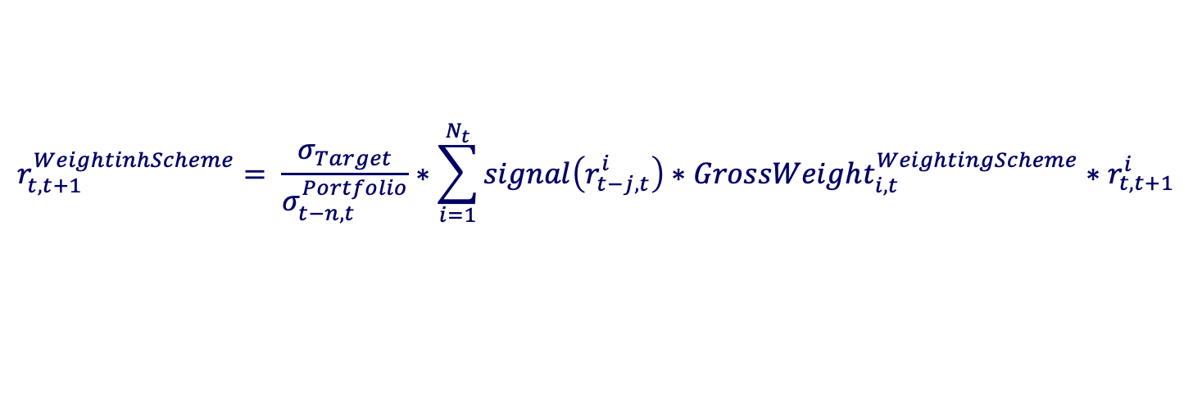
Methodology
How do we implemented the Trend following ?
$$r_{t,t+1}^{WeightinhScheme}= \frac{σ_{Target}}{σ_{t−n,t}^{Portfolio}}∗\sum_{i=1}^{N_{t}}{signal\left(r_{t−j,t}^{i}\right)∗GrossWeight_{i,t}^{WeightingScheme}∗r_{t,t+1}^{i}}$$
Scaling factor
Momentum
Moving Average
EWMA
SSA
SVM
Equally Weighted
Volatility Parity
Risk Parity
Maxime Borel & Benjamin Souane
QARM II – 17.12.2020
Notes:
M

Slide 6

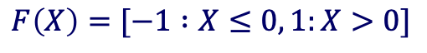
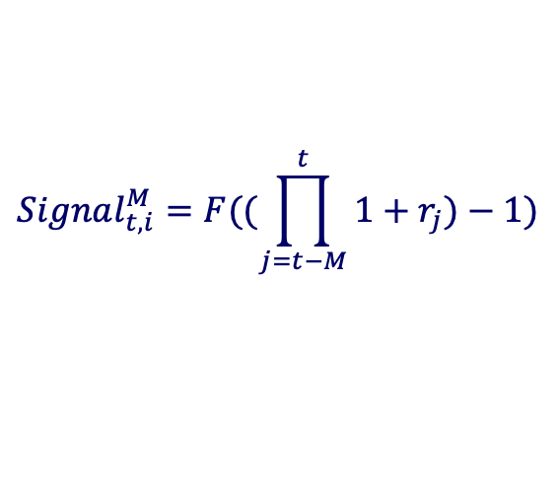
Benchmarks – Framework
Momentum & Moving average
Simplest models
MOM
252
90 & 90JUMP
MA
21days – 63 days
Volatility target – 10%
$$Signal_{t,i}^{M}=F((\prod_{j=t−M}^{t}{1+r_{j}})−1)$$
$$Signal_{t,i}^{MA}=F(MA_{ShortTerm}−MA_{LongTerm})$$
$$F\left(X\right)=[−1 :X≤0, 1:X>0]$$
Maxime Borel & Benjamin Souane
QARM II – 17.12.2020

Slide 7
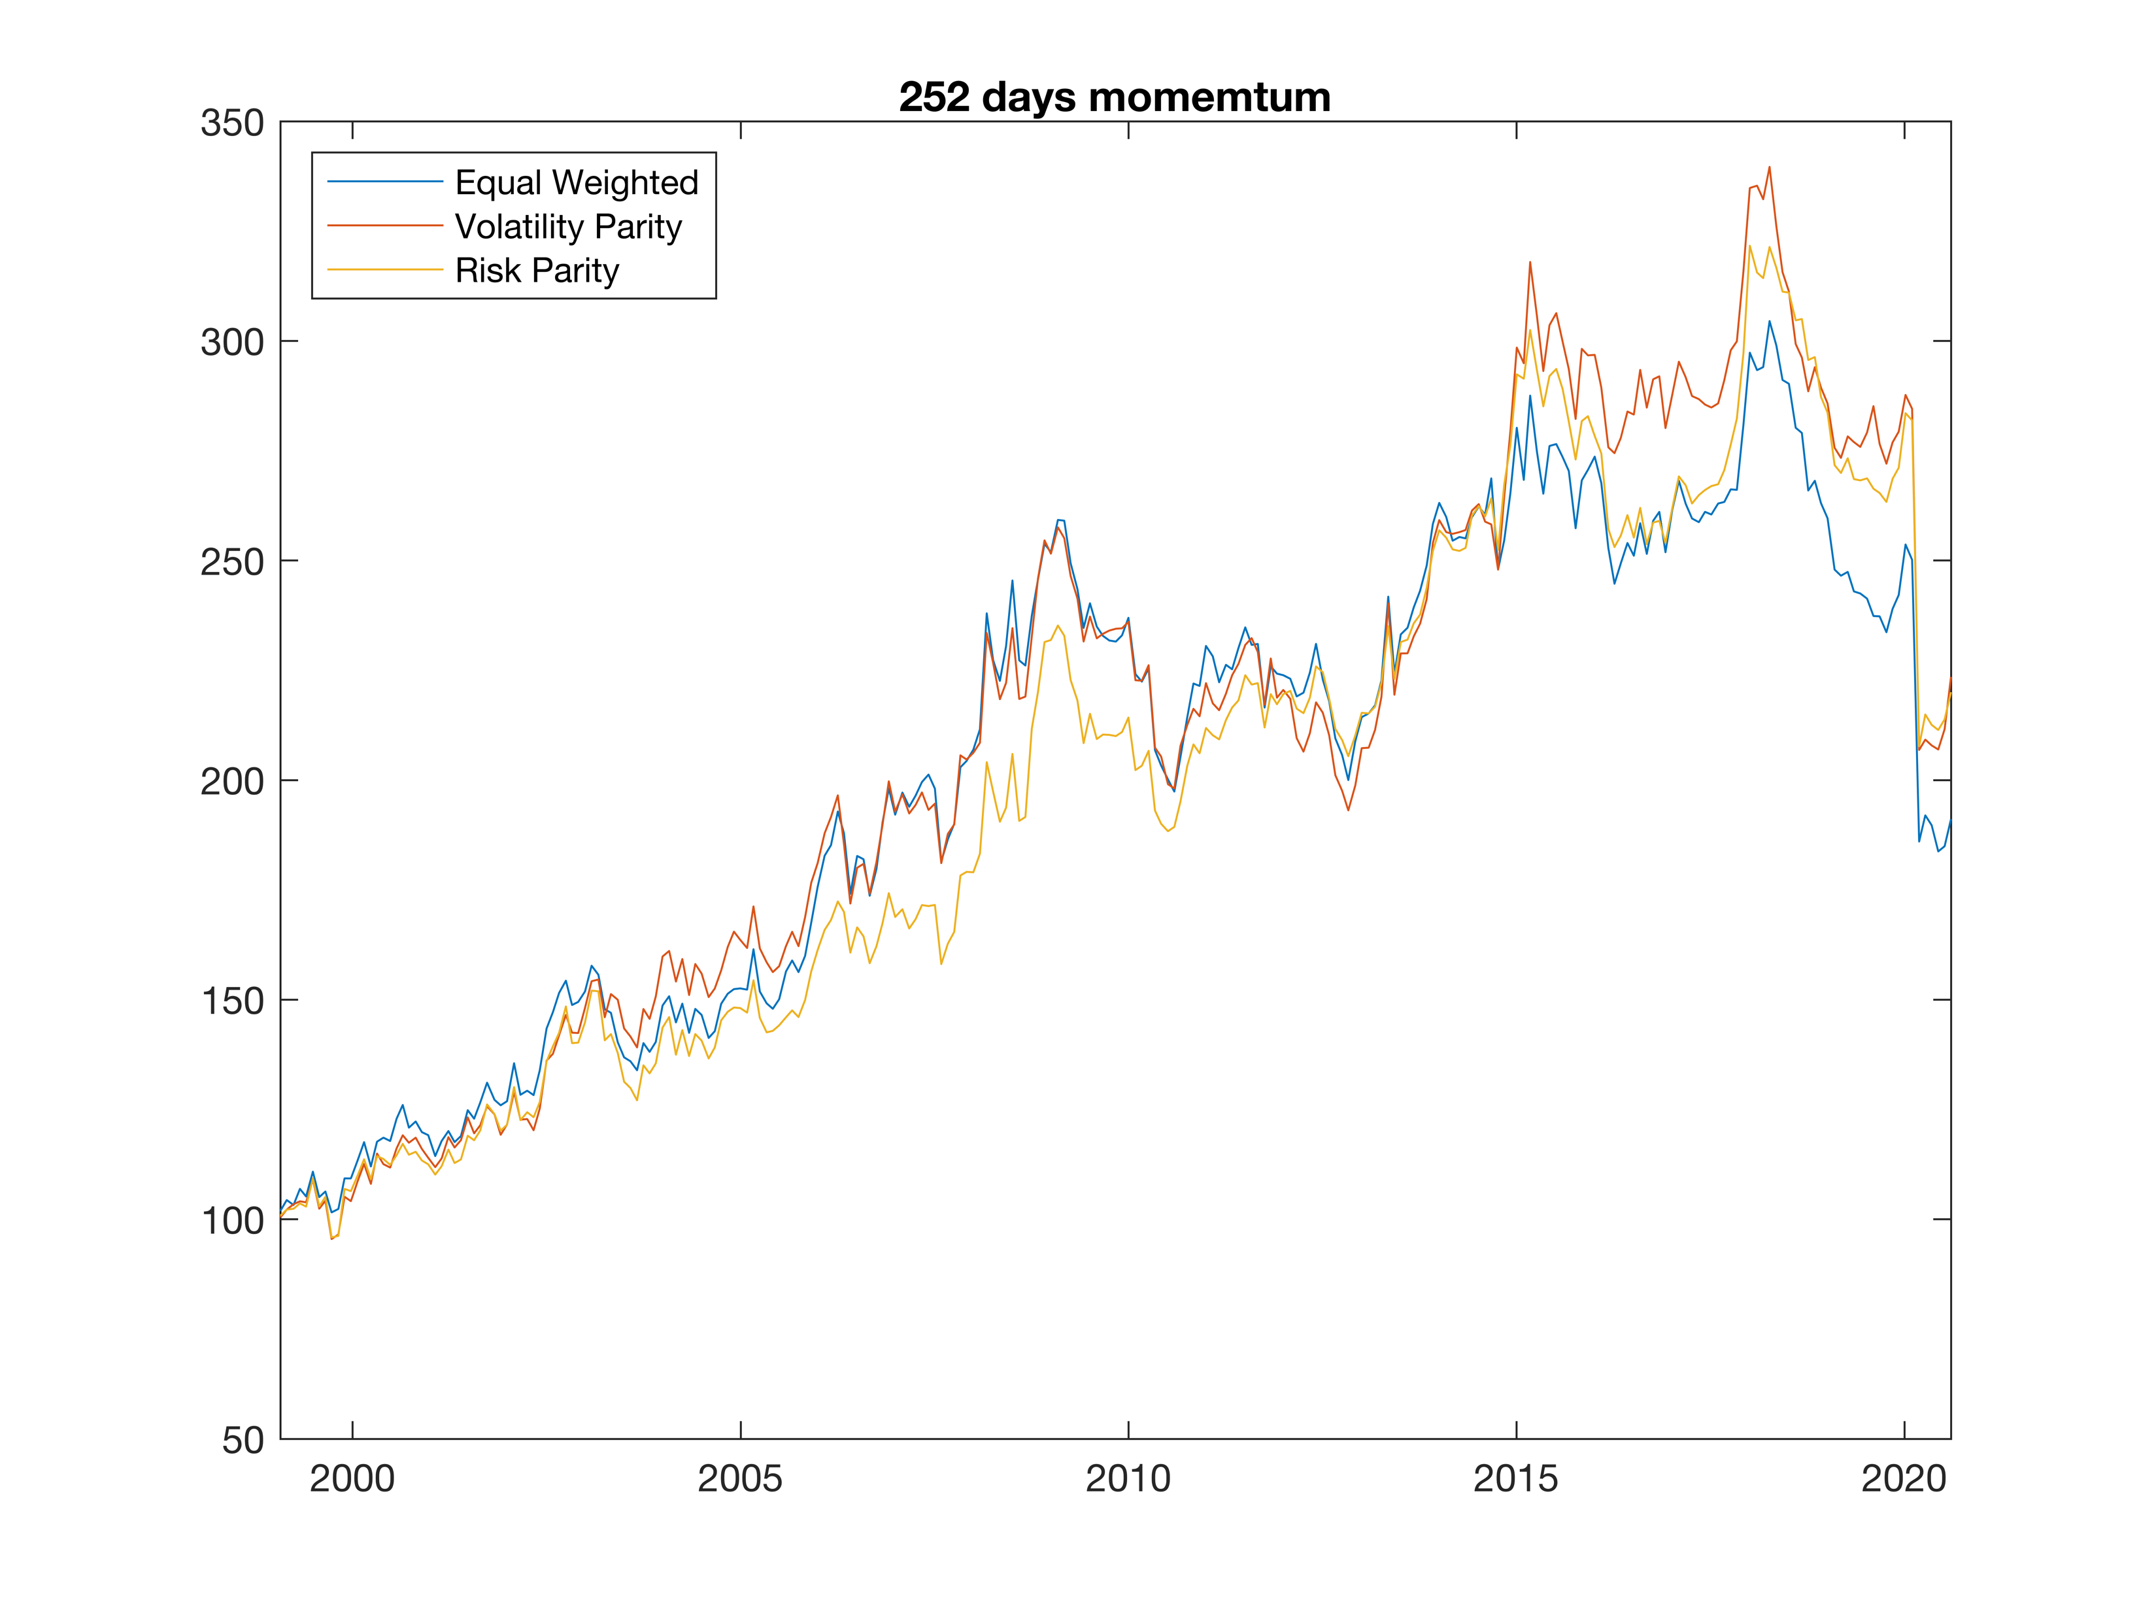
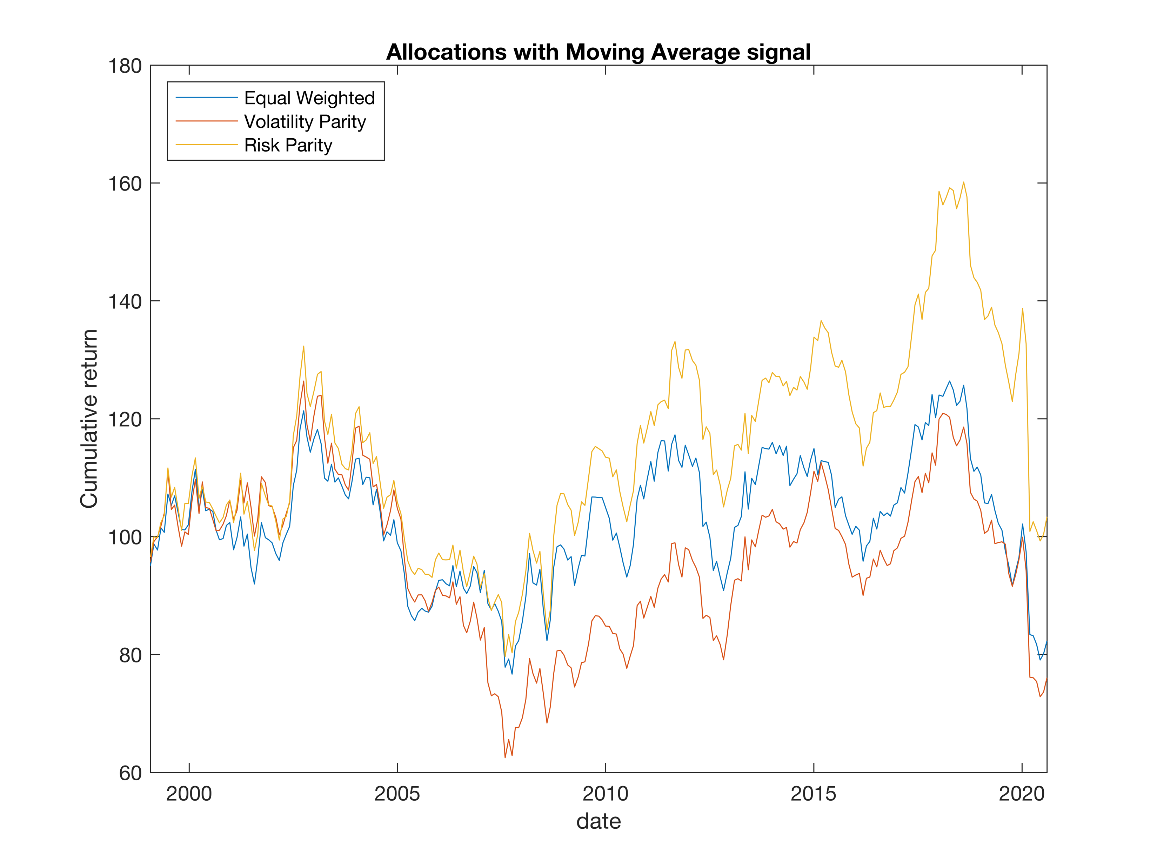
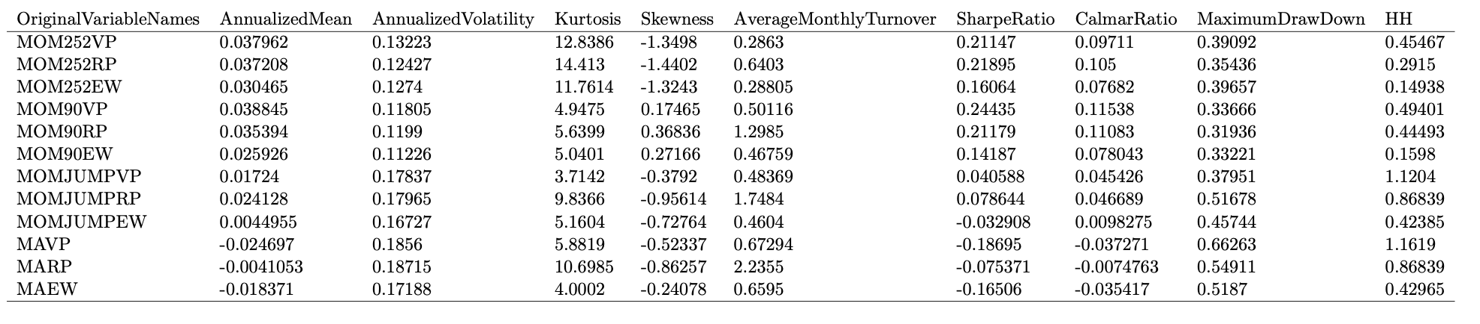
Benchmarks – Results
Momentum & Moving average
Maxime Borel & Benjamin Souane
QARM II – 17.12.2020

Slide 8
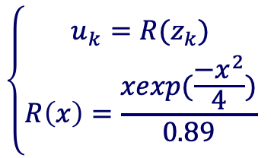
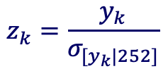
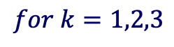
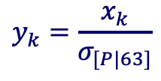
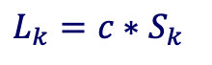
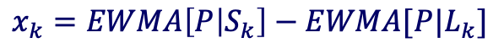
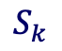
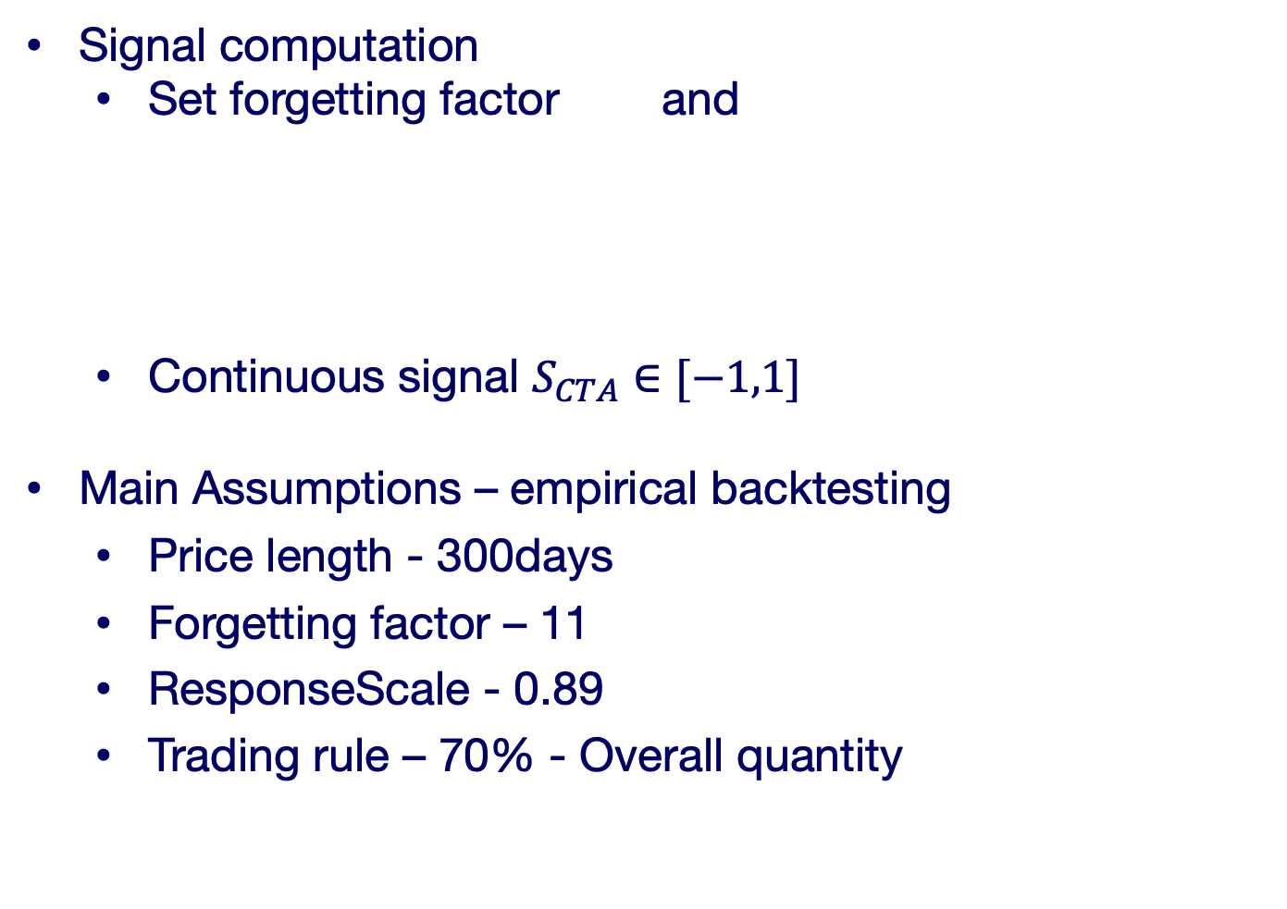
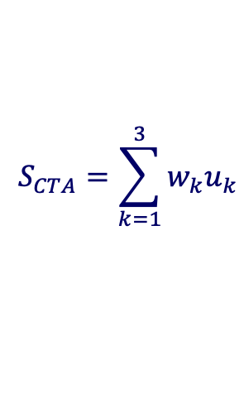
Results – EWMA - Framework
Signal and assumptions
Signal computation
Set forgetting factor and
Continuous signal $S_{CTA}∈[−1,1]$
Main Assumptions – empirical backtesting
Price length - 300days
Forgetting factor – 11
ResponseScale - 0.89
Trading rule – 70% - Overall quantity
$$S_{k}$$
$$L_{k}={c∗S}_{k}$$
$$for k=1,2,3$$
$$x_{k}=EWMA\left[P | S_{k}\right]−EWMA[P|L_{k}]$$
$$\left\{\begin{aligned}u_{k}=R(z_{k}) \\ R\left(x\right)=\frac{xexp(\frac{−x^{2}}{4})}{0.89}\end{aligned}\right.$$
$$y_{k}=\frac{x_{k}}{σ_{[P|63]}}$$
$$S_{CTA}=\sum_{k=1}^{3}{w_{k}u_{k}}$$
$$z_{k}=\frac{y_{k}}{σ_{[y_{k}|252]}}$$
Maxime Borel & Benjamin Souane
QARM II – 17.12.2020

Slide 9
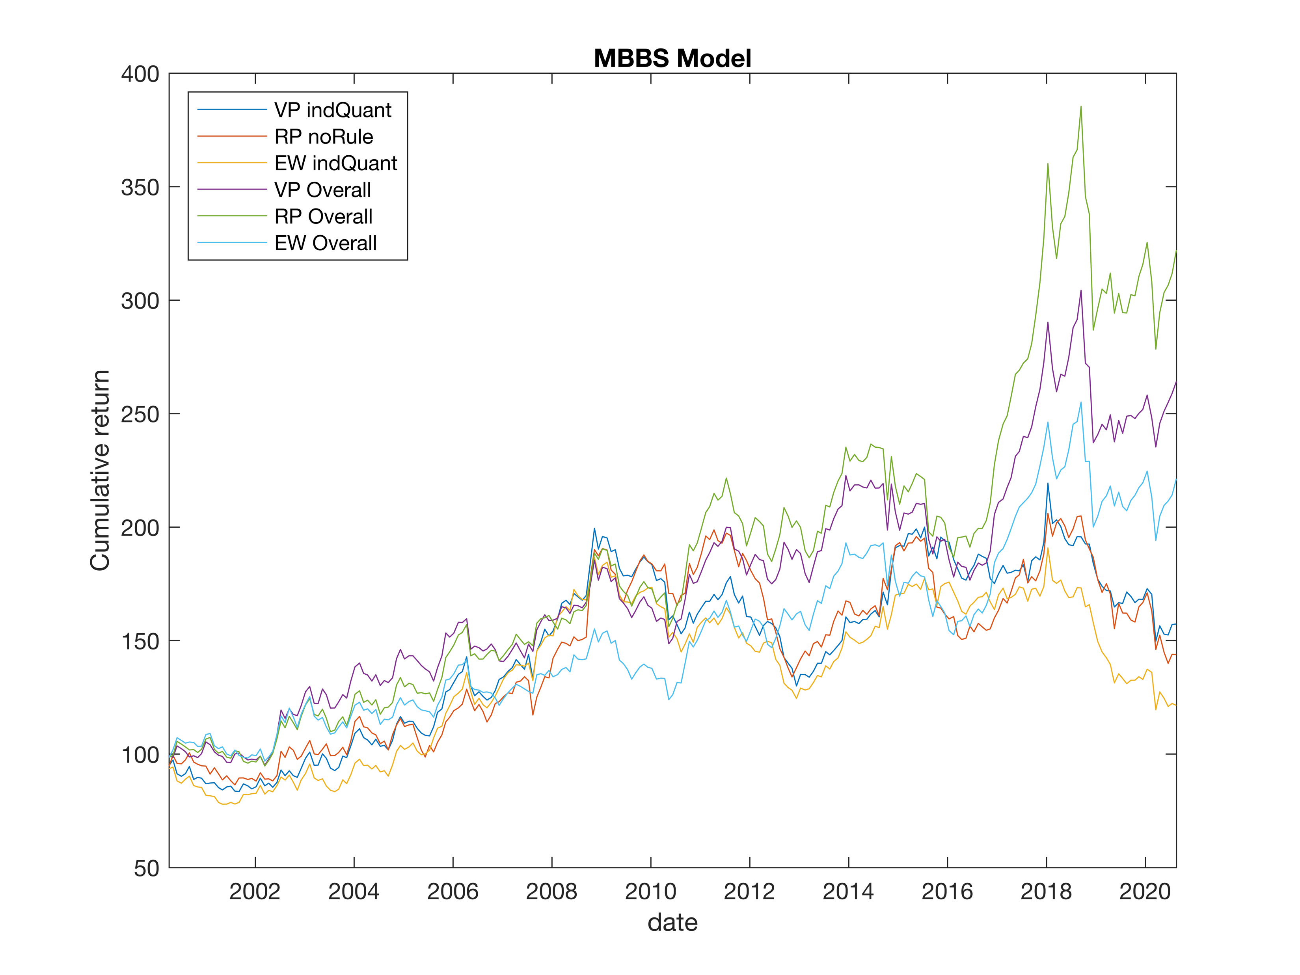
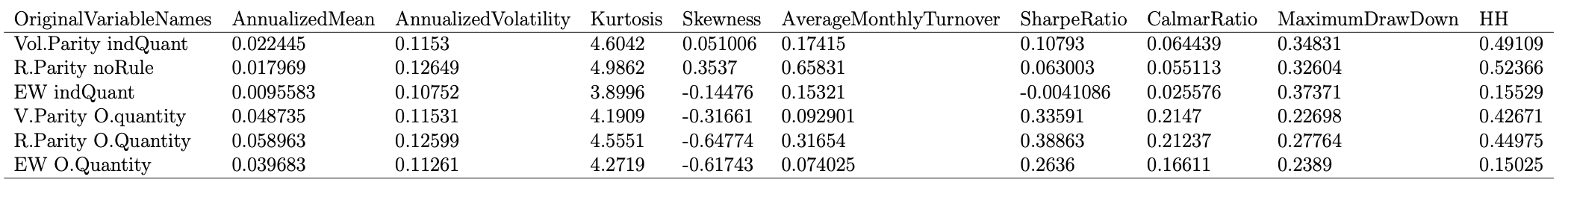
Results – EWMA - Performance
Maxime Borel & Benjamin Souane
QARM II – 17.12.2020

Slide 10
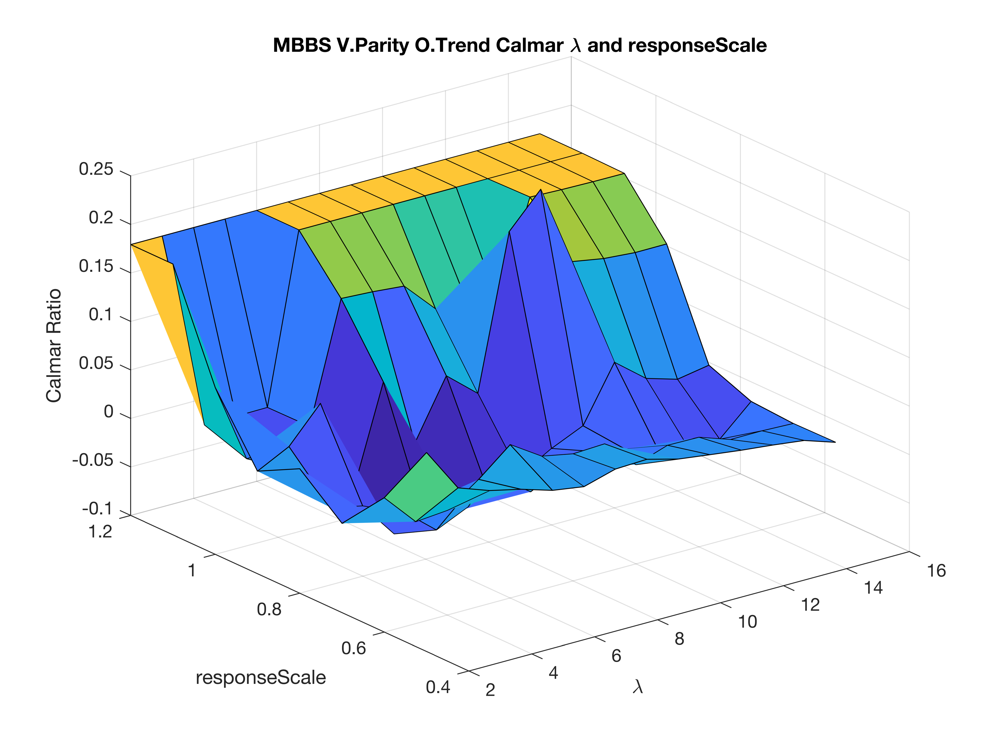
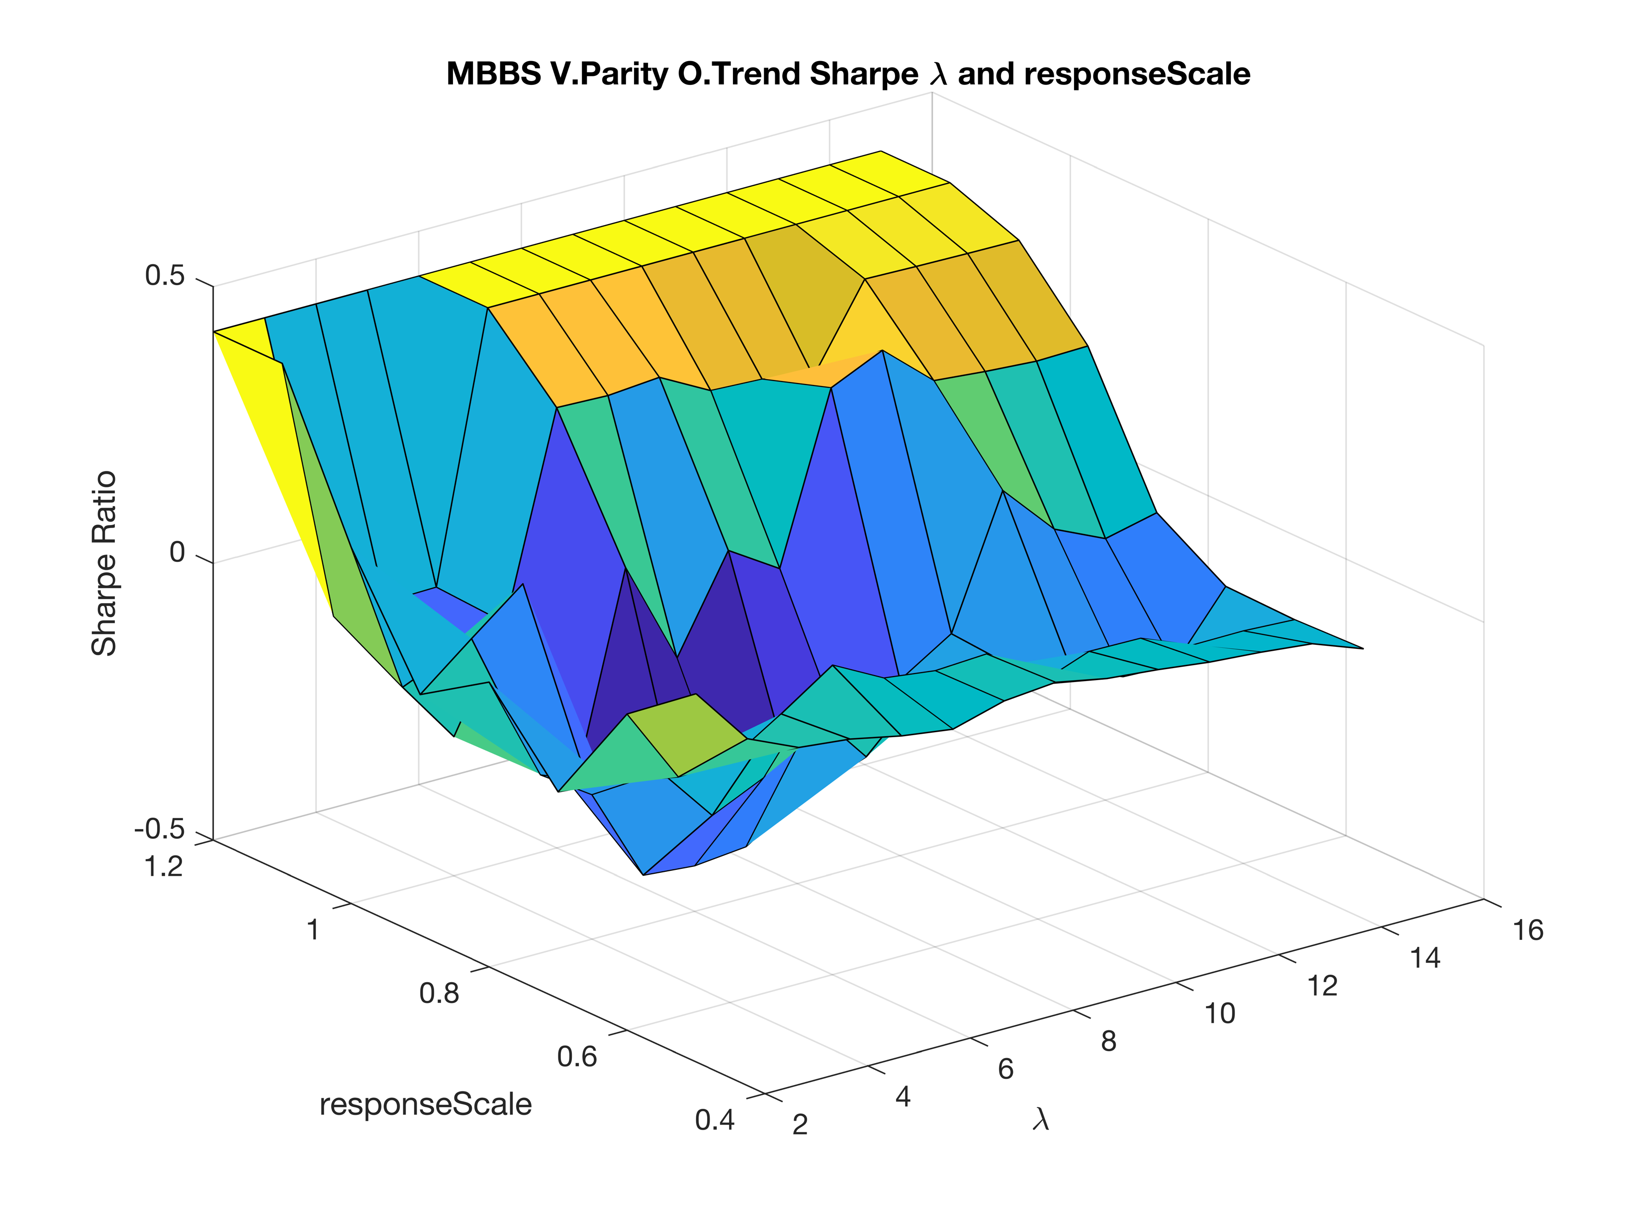
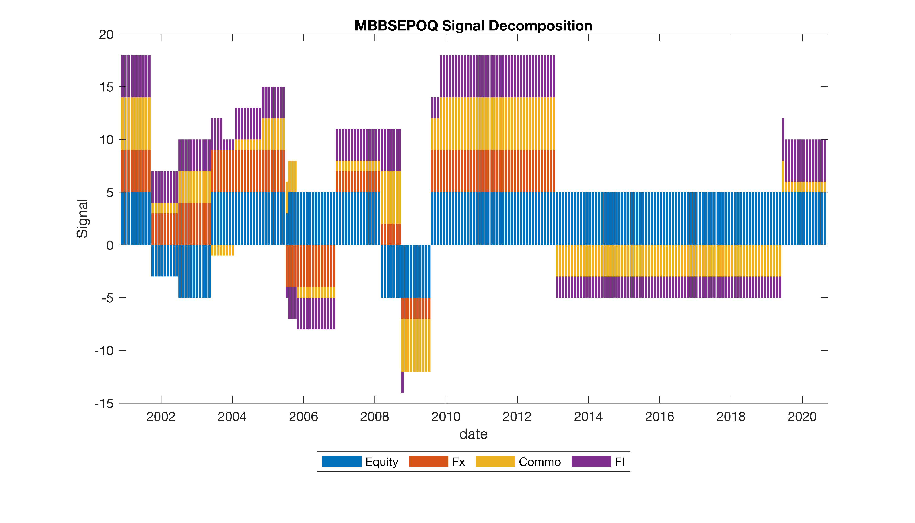
Results – EWMA – Sensitivity Analysis
Impact of the trading rule
Maxime Borel & Benjamin Souane
QARM II – 17.12.2020

Slide 11
Results – EWMA – Conclusion
Conclusion
Better than momentum
Trading rule helps a lot but …
Highly sensitive model
Maxime Borel & Benjamin Souane
QARM II – 17.12.2020

Slide 12
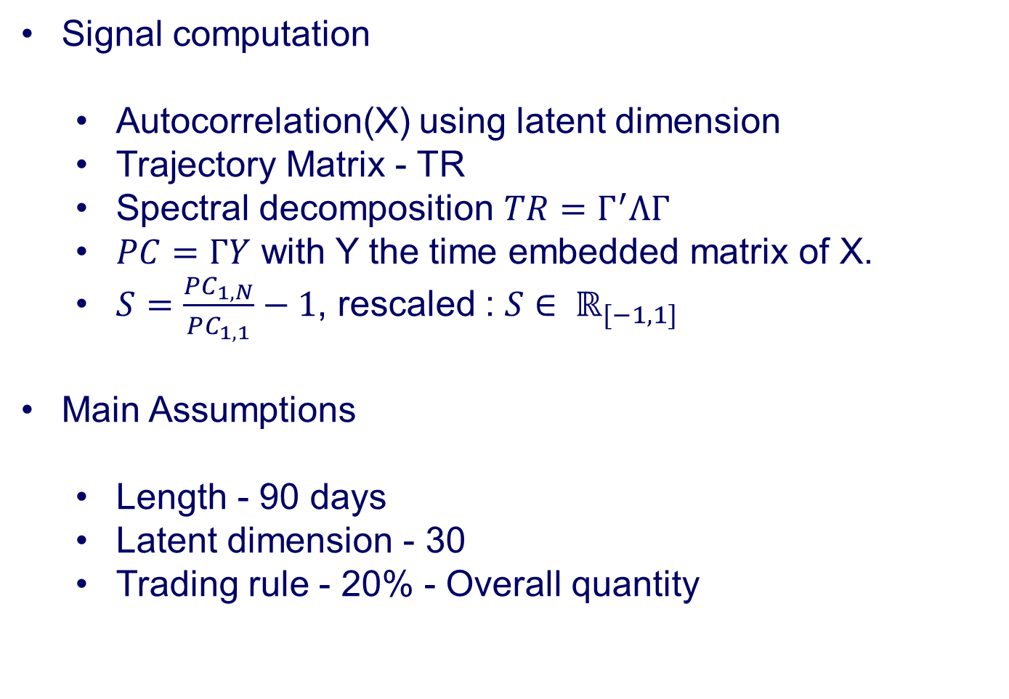
Results – SSA - Framework
Signal and assumptions
Signal computation
Autocorrelation(X) using latent dimension
Trajectory Matrix - TR
Spectral decomposition $TR=Γ^{′}ΛΓ$
$PC=ΓY$ with Y the time embedded matrix of X.
$S=\frac{PC_{1,N}}{PC_{1,1}}−1$, rescaled : $S∈ ℝ_{[−1,1] }$
Main Assumptions
Length - 90 days
Latent dimension - 30
Trading rule - 20% - Overall quantity
Maxime Borel & Benjamin Souane
QARM II – 17.12.2020

Slide 13
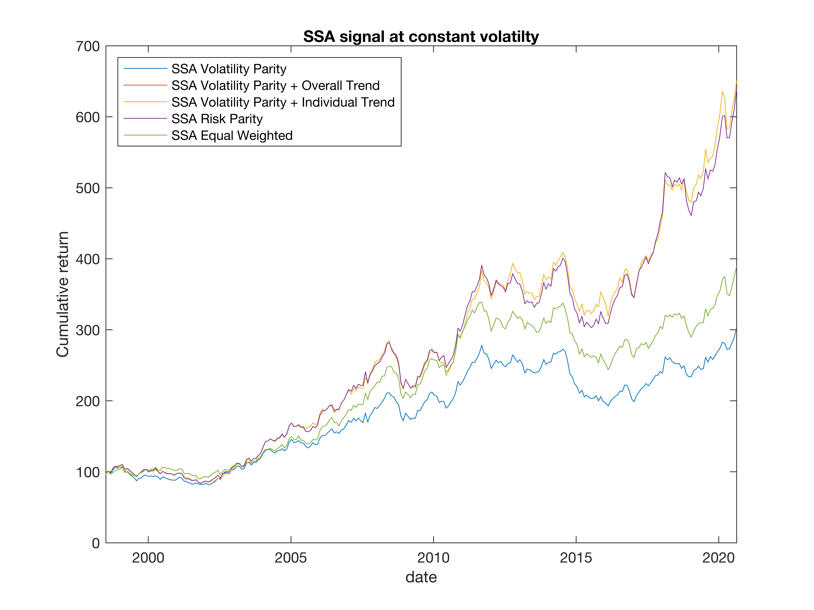
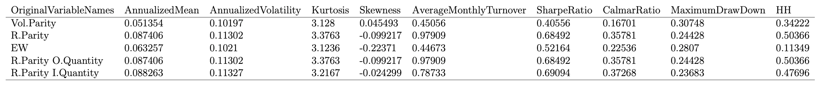
Results – SSA - Performance
Maxime Borel & Benjamin Souane
QARM II – 17.12.2020

Slide 14
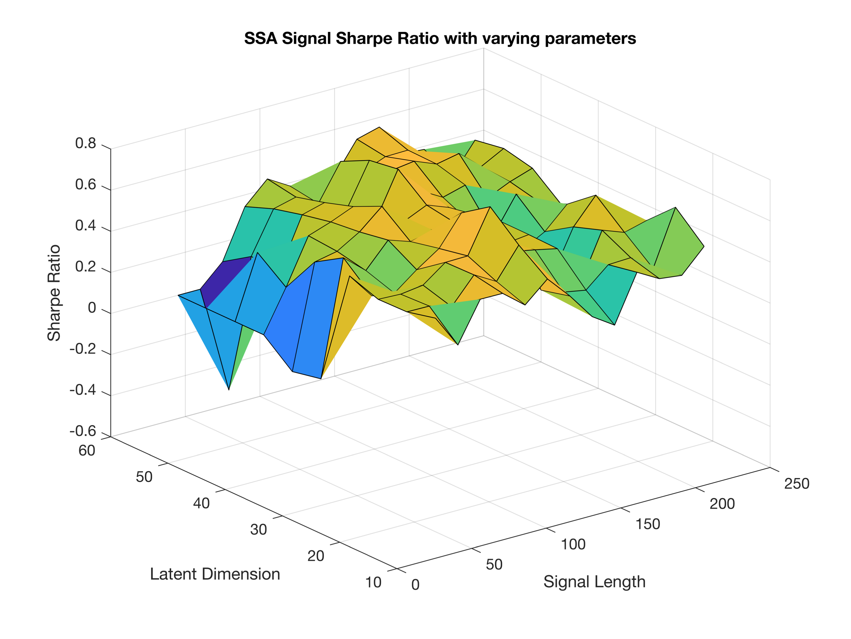
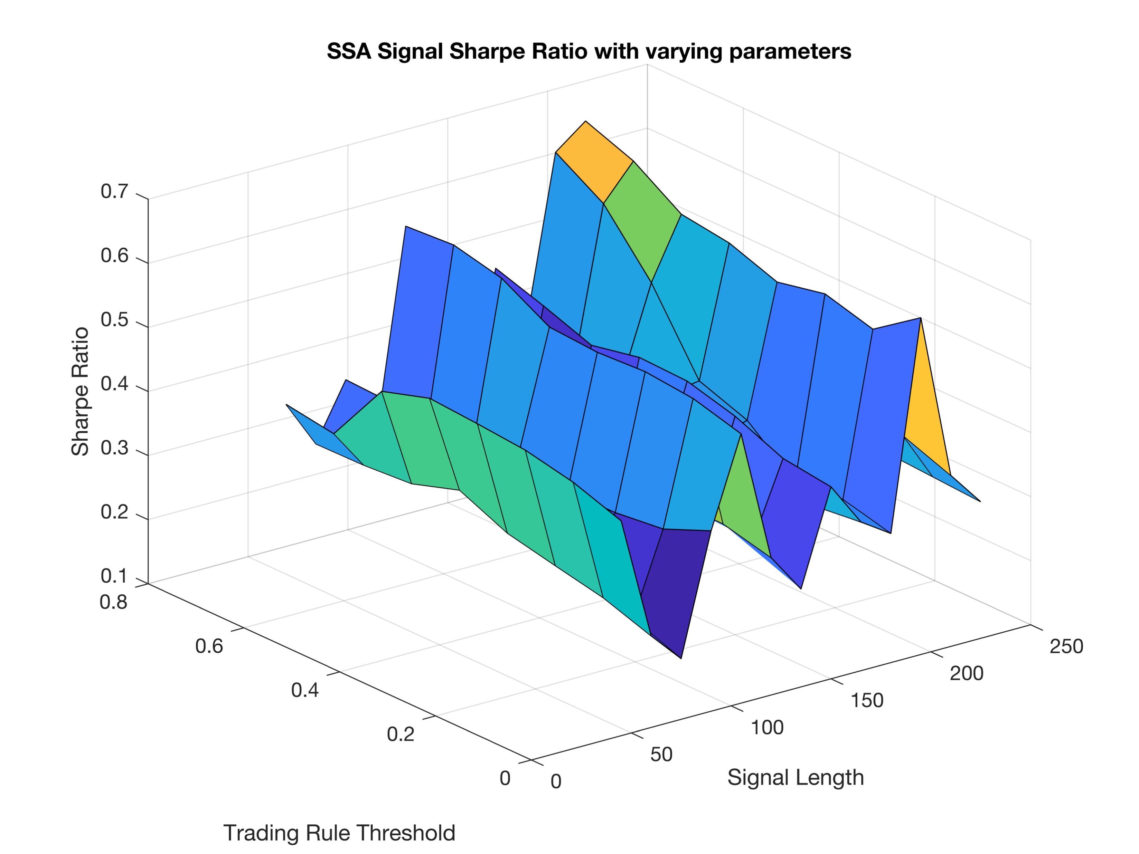
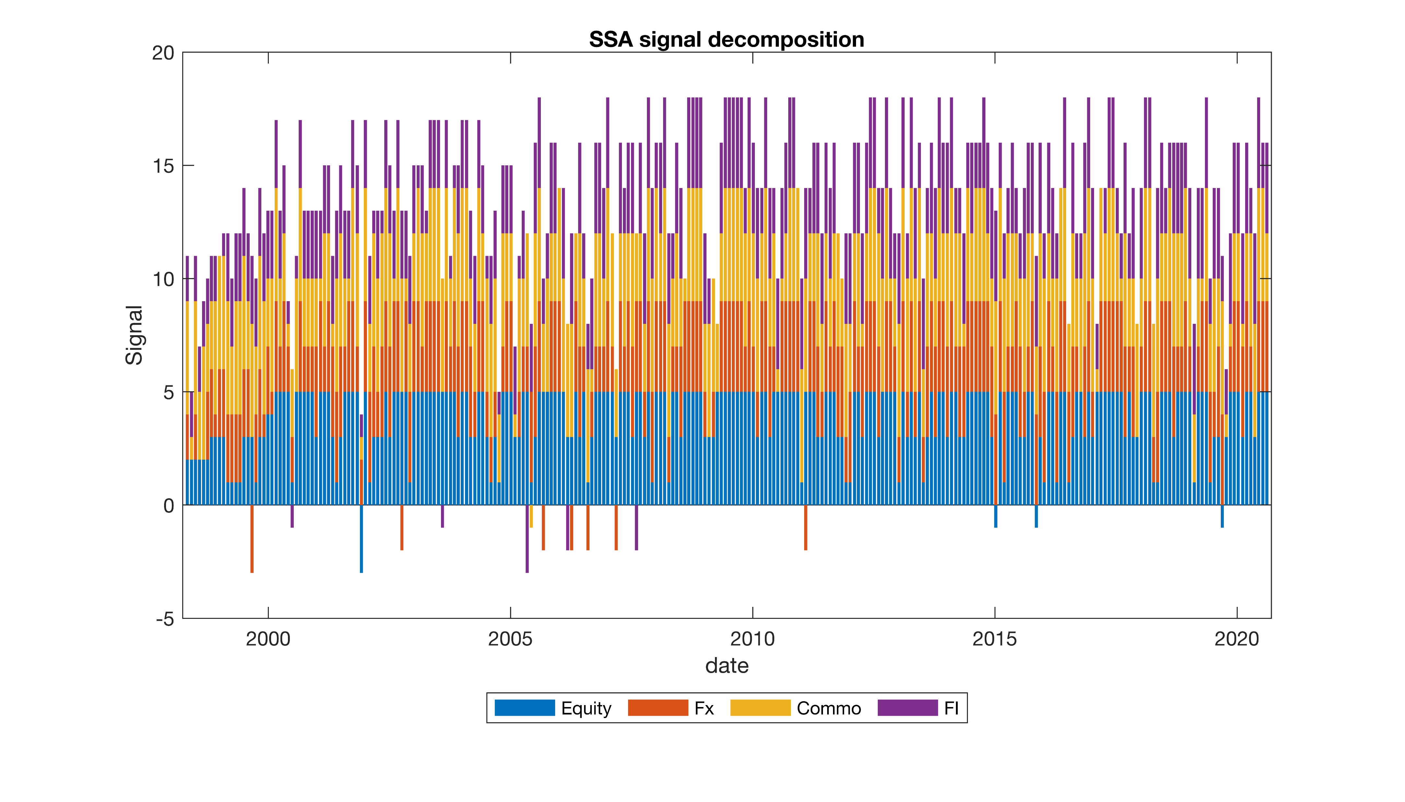
Results – SSA – Sensitivity Analysis
Maxime Borel & Benjamin Souane
QARM II – 17.12.2020

Slide 15
Results – SSA – Conclusion
Strong Performance
Robust to sensitivity analysis
Reduced Drawdown
Negative relationship with correlations
Maxime Borel & Benjamin Souane
QARM II – 17.12.2020

Slide 16


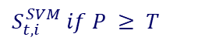
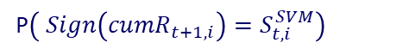

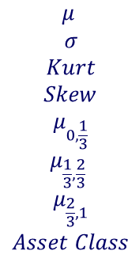
Results – SVM - Framework
Signal and assumptions
Signal computation
Main Assumptions & implementation
Kernel - RBF
Probability threshold - 20%
Length features - 90 days
$$\begin{aligned}\begin{aligned}μ \\ σ \\ Kurt \\ Skew \\ μ_{0,\frac{1}{3}} \\ μ_{\frac{1}{3},\frac{2}{3}} \end{aligned} \\ μ_{\frac{2}{3},1} \\ Asset Class\end{aligned}$$
$S_{t,i}^{SVM} if P ≥ T$
$S_{t,i}^{SVM}∈\{−1, 1\}$
Support Vector Machine
$0 otherwise$
P$\left( Sign\left({cumR}_{t+1,i}\right)=S_{t,i}^{SVM}\right)$
$$T∈ℝ[0, 1]$$
Maxime Borel & Benjamin Souane
QARM II – 17.12.2020

Slide 17
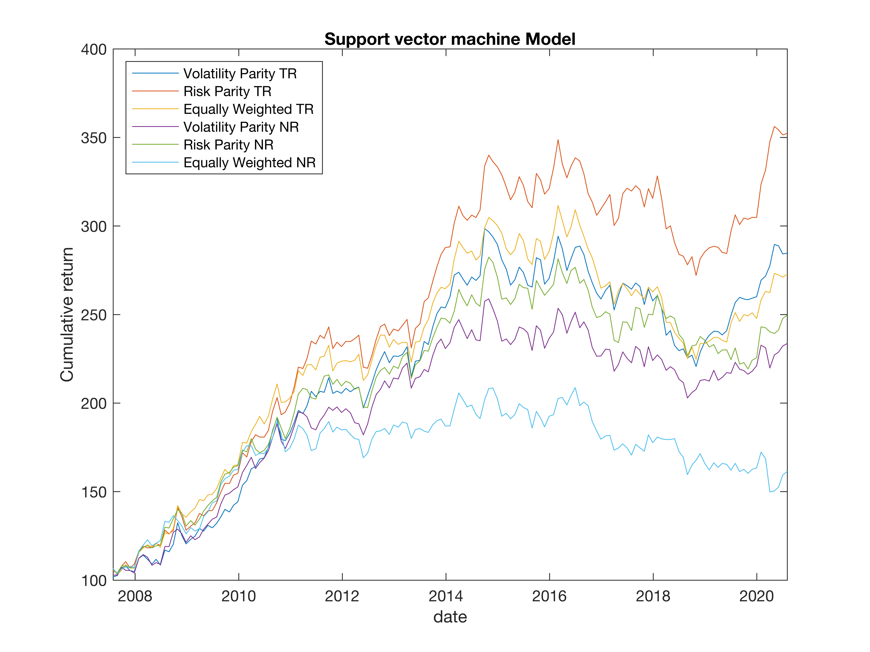
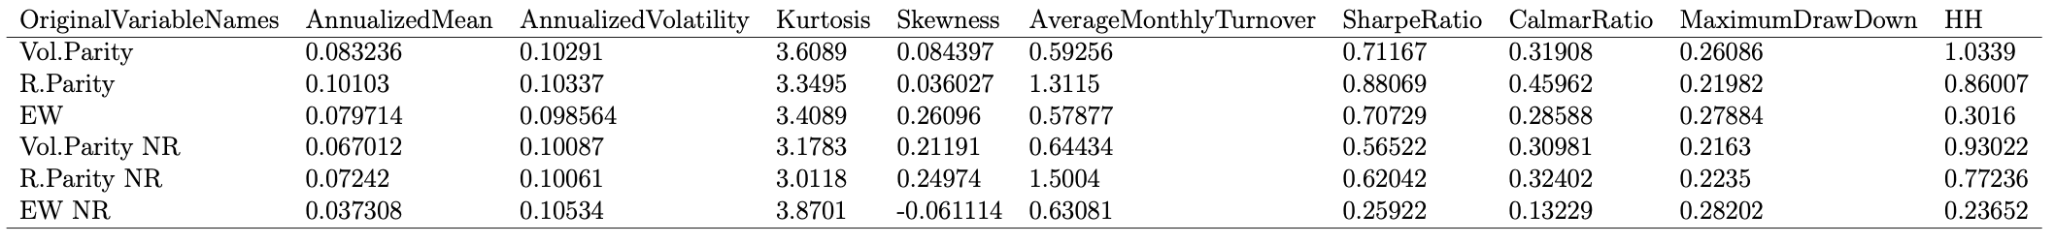
Results – SVM - Performance
Maxime Borel & Benjamin Souane
QARM II – 17.12.2020

Slide 18
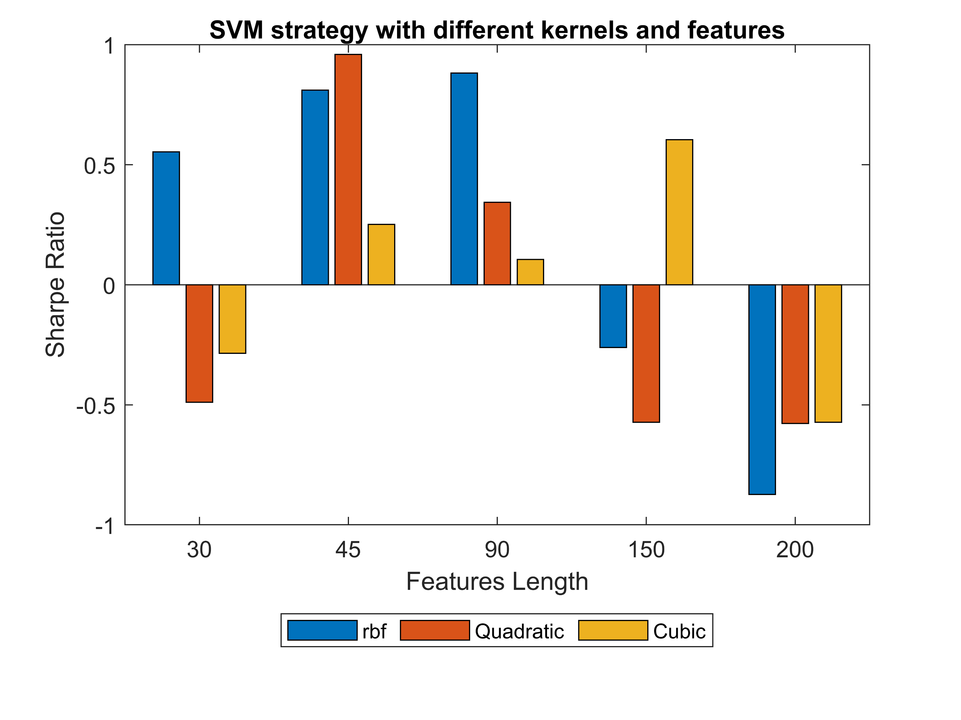
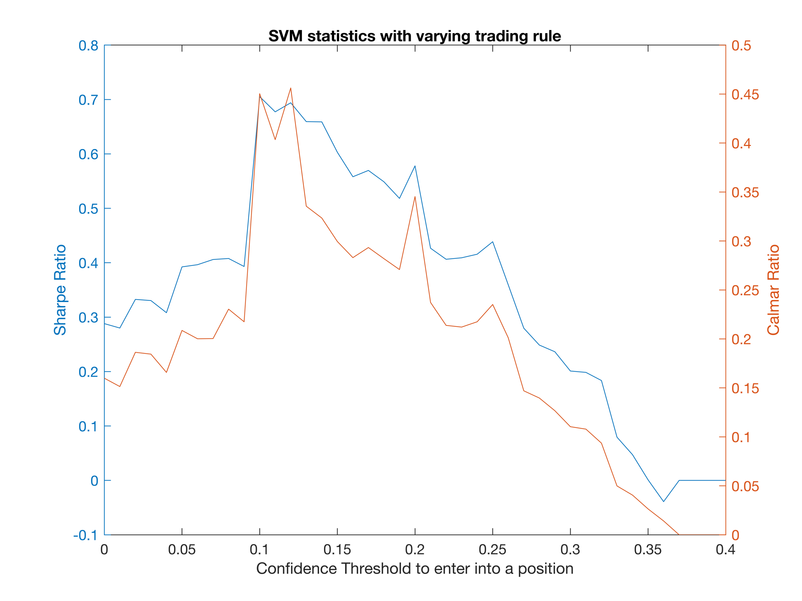
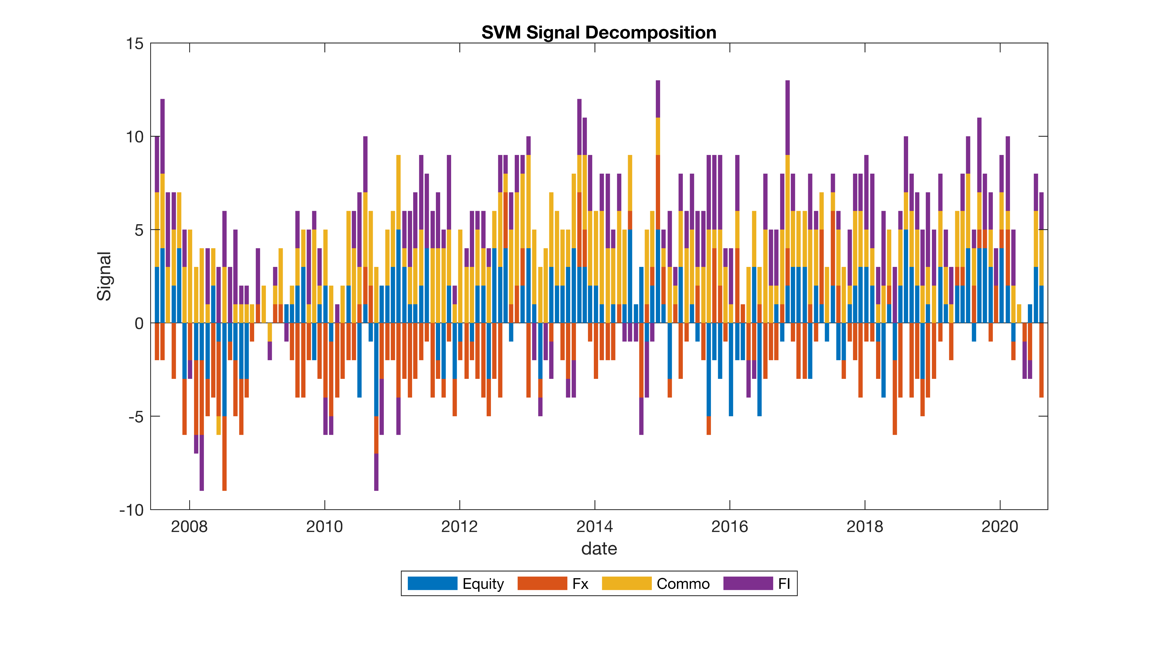
Results – SVM – Sensitivity Analysis
Maxime Borel & Benjamin Souane
QARM II – 17.12.2020

Slide 19
Results – SVM – Conclusion
Best Performance
Robust to correlation regimes
MDD Strongly Reduced
Benefits of “Buzz word”
Growing research on the subject
Maxime Borel & Benjamin Souane
QARM II – 17.12.2020

Slide 20








Limits and Improvements
Limits
Operational implementation
In and out of sample
Sensitiveness of the models
Improvements
Combinaison of the models
Dynamically training the models
Label learning for SVM
Maxime Borel & Benjamin Souane
QARM II – 17.12.2020
Notes:
M

Slide 21
References
X.Wang, A.Smith, R.Hyndman. “Dimension Reduction for Clustering Time Series Using Globl Characteristics”. In: Springer (2005).
T.Alexandrov. “A Method of trend extraction using singular spectrum analysis”. In: Statistical Journal 7.1 (2009), pp. 1–22.
Bruder, Dao, Richard and Roncalli. “Trend Filtering Methods for Momentum Strategies: Lyxor Asset Management”. In: (2011).
Ooi Moskowitz and Pedersen. “Time series momentum”. In: Journal of financial Economics 104 (2012), pp. 228–250. doi: 10.1016/j.jfineco.2011.11.003. url: doi:10.1016/j.jfineco.2011.11.003.
Baltas. “Trend-Following, Risk-Parity and the Influence of Correlations”. In: Risk Based and Factor Investing (2015).
Jamil Baz, Nick Granger, Campbell R. Harvey, Nicolas Le Roux and Sandy Rattray. “Dissecting Investment Strategies in the Cross Section and Time Series.” In: (2015). doi: 10.2139/ssrn.2695101. (Visited on ).
Xiong and Ibbotson. “Momemtum Acceleration and Reversal”. In: Journal of Investment Management 13.1 (2015), pp. 84–95.
Daniel and Moskowitz. “Momentum Crahses”. In: Journal of financial Economics 122 (2016), pp. 221–247. doi: 10.1016/j.jfineco.2015.12.002.
Levine and Pedersen. “Which Trend Is Your Friend?” In: Financial Analyst Journal 72.3 (2016), pp. 51–66.
Maxime Borel & Benjamin Souane
QARM II – 17.12.2020

Slide 22
References cont.
Yu and Webb. “CAN FUNDAMENTAL FACTORS ENHANCE THE PERFORMANCE OF TRADITIONAL MOMENTUM STRATEGIES?” In: Journal of Investment Management 14.4 (2016), pp. 28–43.
Federico Nucera. “Risk-Managed Momentum: The effect of leverage constraints”. In: (2017). url: https://ssrn.com/abstract=3008530.
Baltas and Kosowski. “Demystifying Time-series Momentum Strategies: Volatility Estimators, Trading Rules and Pairwise Correlations”. In: SSRN Electronic Journal (2019). doi: 10.2139/ssrn.2140091. url: https://ssrn.com/abstract=2140091
Michal Balcerak and Thomas Schmelzer. “Constructing trading strategy ensembles by classifying market states”. In: (2020). arXiv: 2012.03078 [q-fin.TR].
Antonacci. “Optimal Momentum: A Global Cross Asset Approach”. In: (). url: https://ssrn.com/abstract=1833722.
B. Hurst, Y.Ooi, L.Pedersen. “A Century of Evidence on Trend-Following Inesting”. In: (). url: https://ssrn.com/abstract=2993026.
Maxime Borel & Benjamin Souane
QARM II – 17.12.2020

Slide 23

Thank you
Questions ?
Notes:
LE QR c’est notre github

